Slide 1

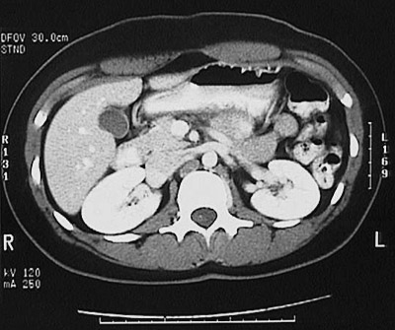
STRG (offsite datacenter)
ADT, ORM, ORU
MHS
Security Admin –(What you can see
data segmentation)
Portal
Portal
Rhapsody
STRG
EI Core
(200k License)
(600k Core)
Logical STRG DB
Methodist
EI Core
(1M License)
(1.6M core)
Rhapsody
Security Admin -
What you can see
(data segmentation)
200,000
(+400k Priors)
DICOM
STRG Cache
(90day)
STRG System Administrator
What you can do
Conditional Routing
Transfer
Shuttle
Logical MHS DB
MPI
ORU
~90 day Cache + Priors
ADT/ORM
1,000,000
MHS System Administrator
What you can do
System Administrator
What you can do
Cloud
Archive
MHS
200,000
(+400k priors)
Slow Archive
2
STRIC
Proxy
1
3
Mammo Administrator
What you can do
MHS Fast Archive
STRIC
Archive
4
Managed Service
SW Only
EI 8.1.1+

Slide 2
STRG
STRG (offsite datacenter)
DMZ
MHS
STRG
EI Core
(200k License)
(600k Core)
Portal
Methodist
EI Core
(1M License)
(1.6M core)
XERO
Reverse Proxy
File
Transfer
Rhapsody
Rhapsody
1
Managed Service
SW Only
EI 8.1.1+

Slide 3
STRG Active-Standby (99.99%)
H/A
1 - Oracle EE
2 - Oracle SE
1x16x64Gb
ODG
1x16x64Gb
APP
CSP
CSP
3-2x16x128Gb
APP
SRM
APP
1-2x16x128Gb
APP
Block
(SAN)
File
File
Block
(SAN)
SR
1-1x16x64Gb
EI 8.1.1+

Slide 4
STRG VM Recommendation
DC #1 Active
DC #2 Standby
DB Cluster
  12 vCPU 84GB RAM vMem
  Agfa would deploy 2x1x16 64GB RAM servers
  Provides N+1 configuration and initial fail
    Over inside DC #1
Application Cluster
  81vCPU 277GB RAM vMEM
  Agfa would deploy 4x2x16 128GB RAM servers
  Provides N+1 configuration
Test Cluster
  14vCPU 60GB RAM vMEM
  Agfa would deploy 1x1x16 64GB RAM
DB Cluster
  12 vCPU 84GB RAM vMEM
  Agfa would deploy 2x1x16 64GB RAM servers
  Provides N+1 configuration and initial fail
Application Cluster
  81vCPU 277GB RAM vMEM
  Agfa would deploy 4x2x16 128GB RAM servers
  Provides N+1 configuration
Clinical Sites Proxy 1,2,3,4, 5,6 … If Required
Site #1
  8vCPU 32GB RAM
Site #2
  8vCPU 32GB RAM
Site #3
  8vCPU 32GB RAM
Site #4
  8vCPU 32GB RAM
Agfa Would deploy 1x16x64 Server for each site
Requiring a proxy

Slide 5
STRG Storage Recommendation
Details available upon request

Slide 6
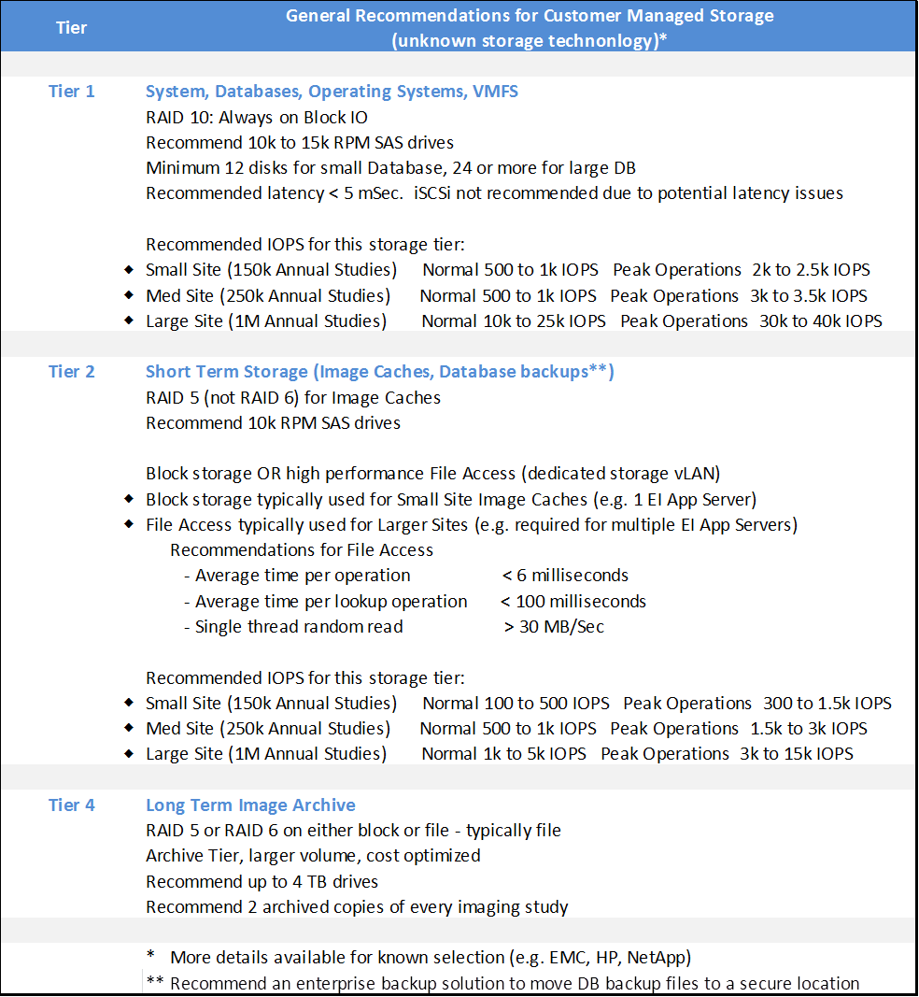

Storage Continued
NA For STRG

Slide 7
STRG Network To Methodist SA

